Slide 1
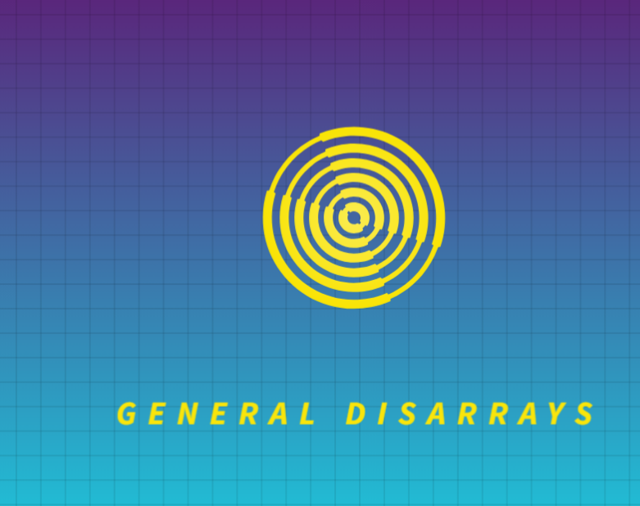
General DisArrays Project Report 1 Team Leader: Jon Mauriala Team Member: Ty Gregory Team Member: Robert Colvin
CSCI363: User Interface Design
Fall 2024 Semester
10/05/2024

Slide 2
Collaboration 9/29
Logo was created by Ty Gregory
Integrated into PowerPoint by Jon Mauriala
Reviewed Logo and opening slide for PowerPoint presentation
Ty Gregory Setup GitHub Repository
Using Discord for collaboration and communication
Scheduled next meeting for 10/06

Slide 3
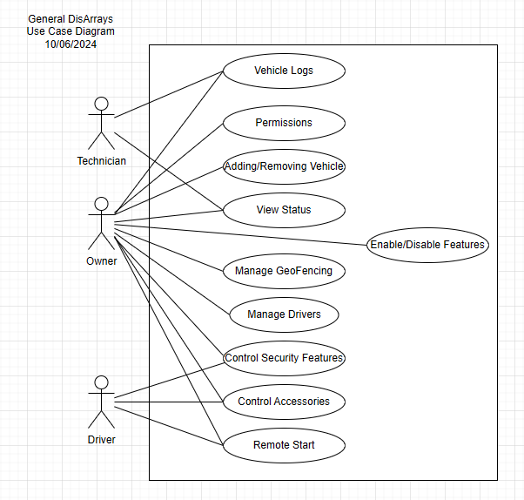

Slide 4
Collaboration 10/06
Implemented Use Case model in Draw.io and Robert Colvin hosted on Google Drive to allow for rapid communication
Scheduled next meeting for 10/06

Slide 5
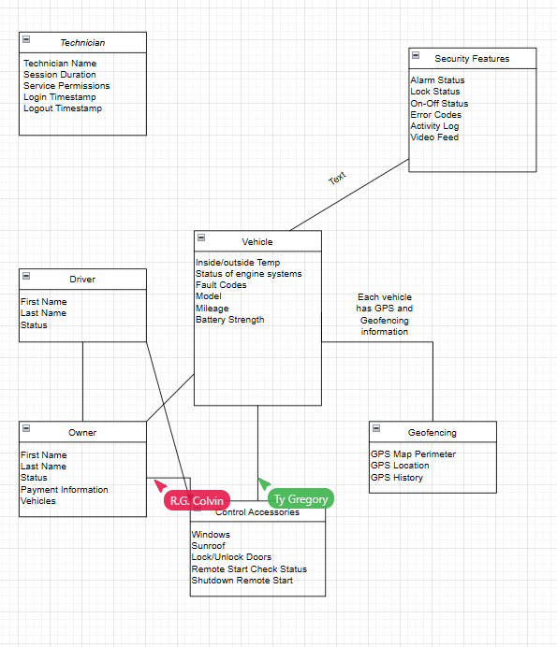

Slide 6
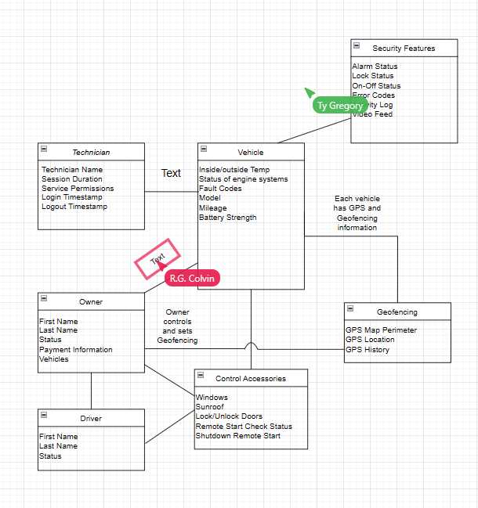

Slide 7
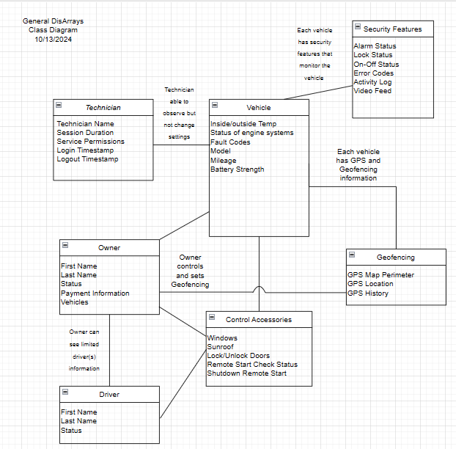

Slide 8
Collaboration 10/13
Implemented Class model in Draw.io and Robert Colvin hosted again on Google Drive to allow for rapid live communication
Notes were added on the lines between the classes to clarify the relationships as well as provide extra context that may not be readily apparent
While generating the Class model we made sure to reflect the Use Diagrams intention within it.
Sent email to customer (Prof Grant) for clarification on Interface Drawing requirements
Scheduled next meeting for 10/20

Slide 9
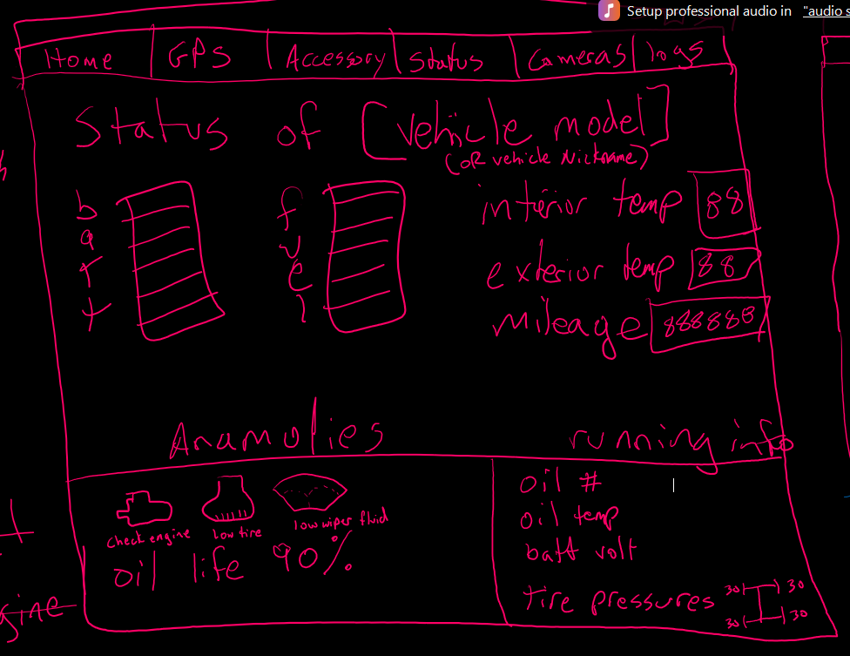
Vehicle Status Screen
The intention is to quickly show the current usability status of the vehicle. Are there any issues, fuel or battery charge status (if a hybrid, both bars will be reflected), etc.

Slide 10
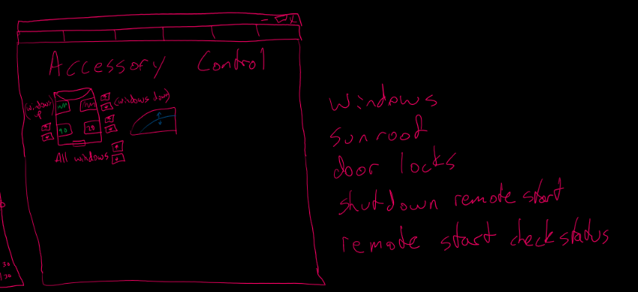
Prototyping Accessories Control Screen

Slide 11
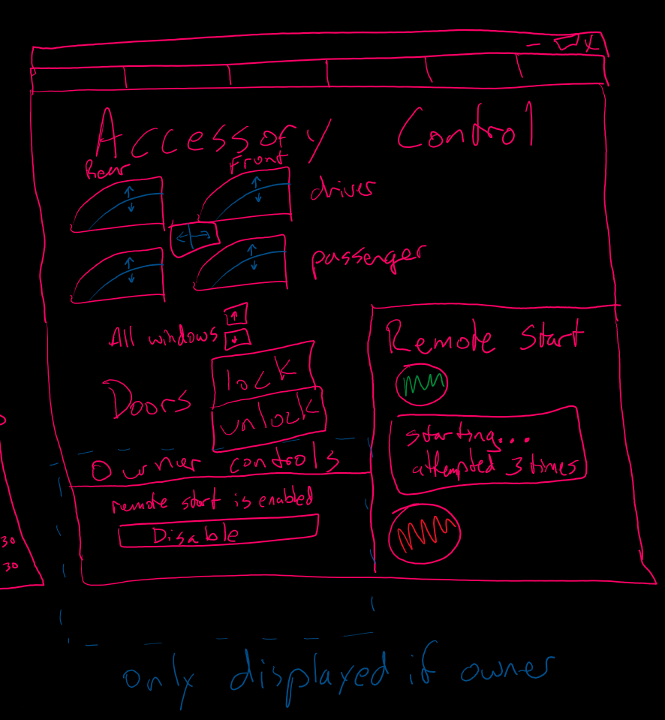
Accessories Control Screen
The intention is to provide visibility and control to the accessories. The windows can be controlled individually or as a group and the current window height is reflected.
Doors can be locked or unlocked, and the status is reflected as well.
The vehicle can be started or stopped from this screen. With a small readout included to display the current status.
The owner can enable/disable the remote start. This area will only be shown when the owner is logged in.

Slide 12
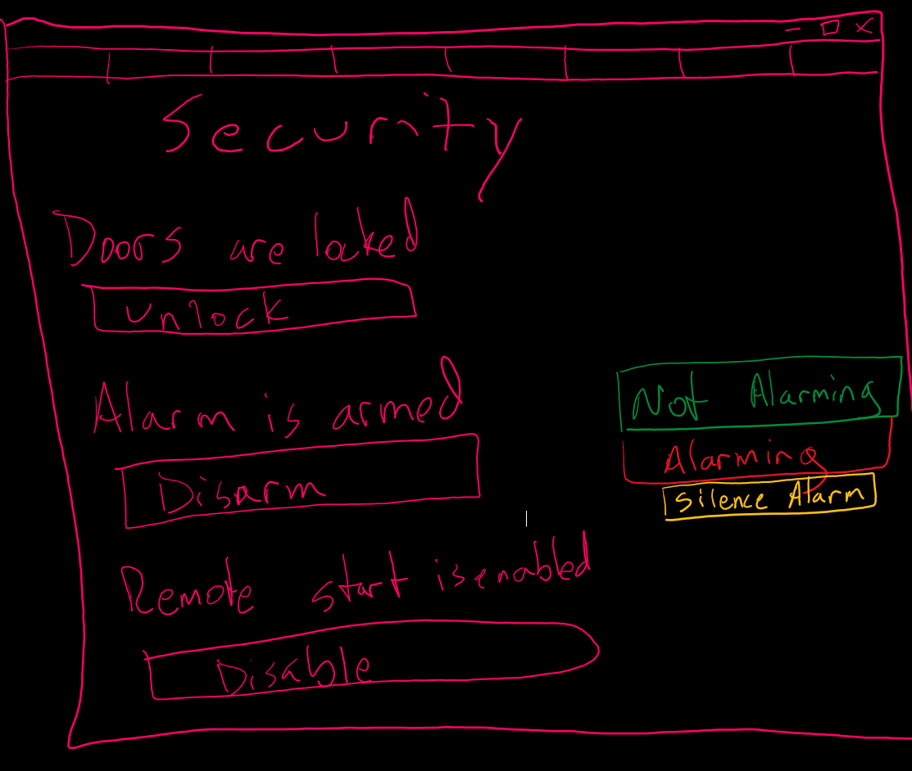
Security Screen
The intention is to provide visibility and control to the accessories. The windows can be controlled individually or as a group and the current window height is reflected.
Doors can be locked or unlocked, and the status is reflected as well.
The vehicle can be started or stopped from this screen. With a small readout included to display the current status.
The owner can enable/disable the remote start. This area will only be shown when the owner is logged in.

Slide 13
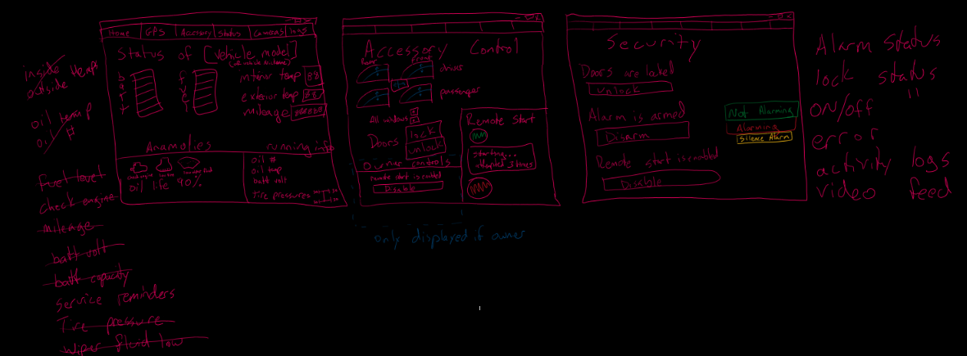
Group shot of all current mockup screens with notes - 1

Slide 14
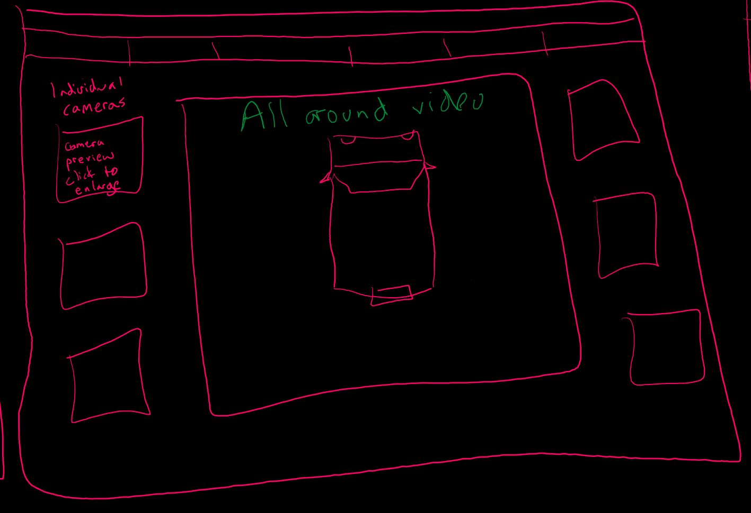
Video Screen
The intention is to provide visibility to all cameras simultaneously. The video feeds can be enlarged by clicking on them.
The total number of actual video feeds is unknown, and this is only for example.
This page has been kept to only video to aid in the separation of concerns and modularity as this page will likely change based on the number of cameras available.

Slide 15
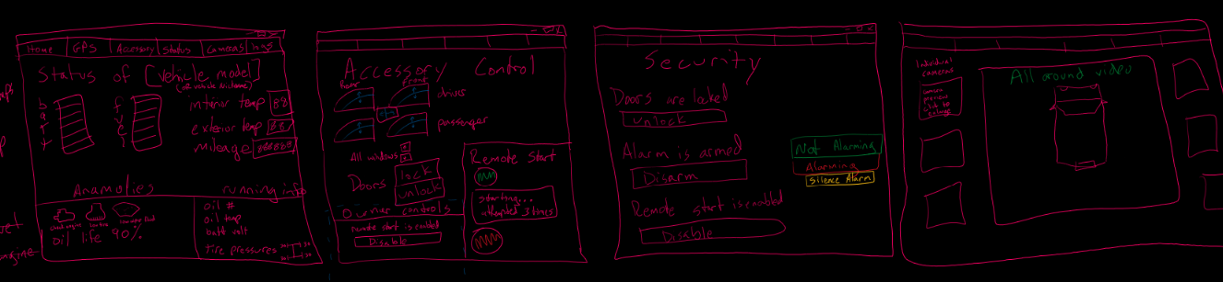
Group shot of all current mockup screens with notes - 2

Slide 16
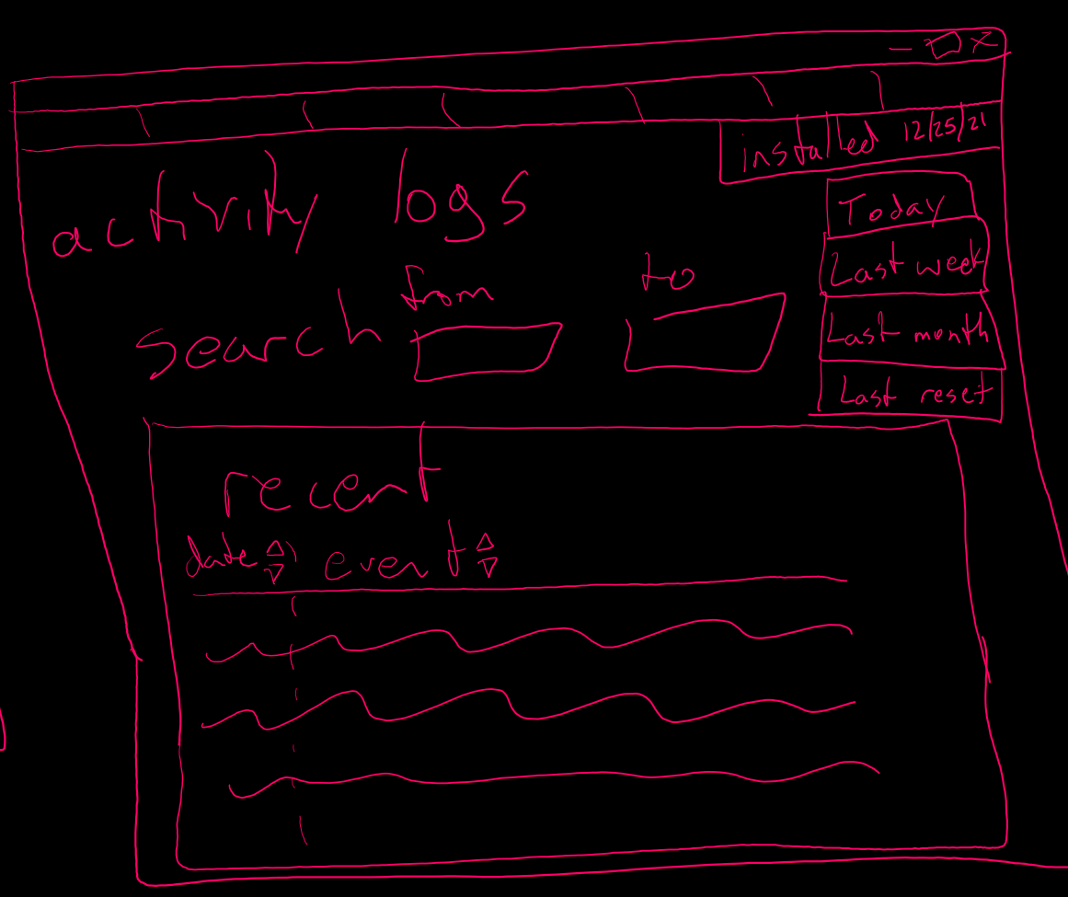
Activity Logs Screen
The stored information from the vehicle will be reflected here with the option to select the pre-created date ranges, or by entering in a specific date range.

Slide 17
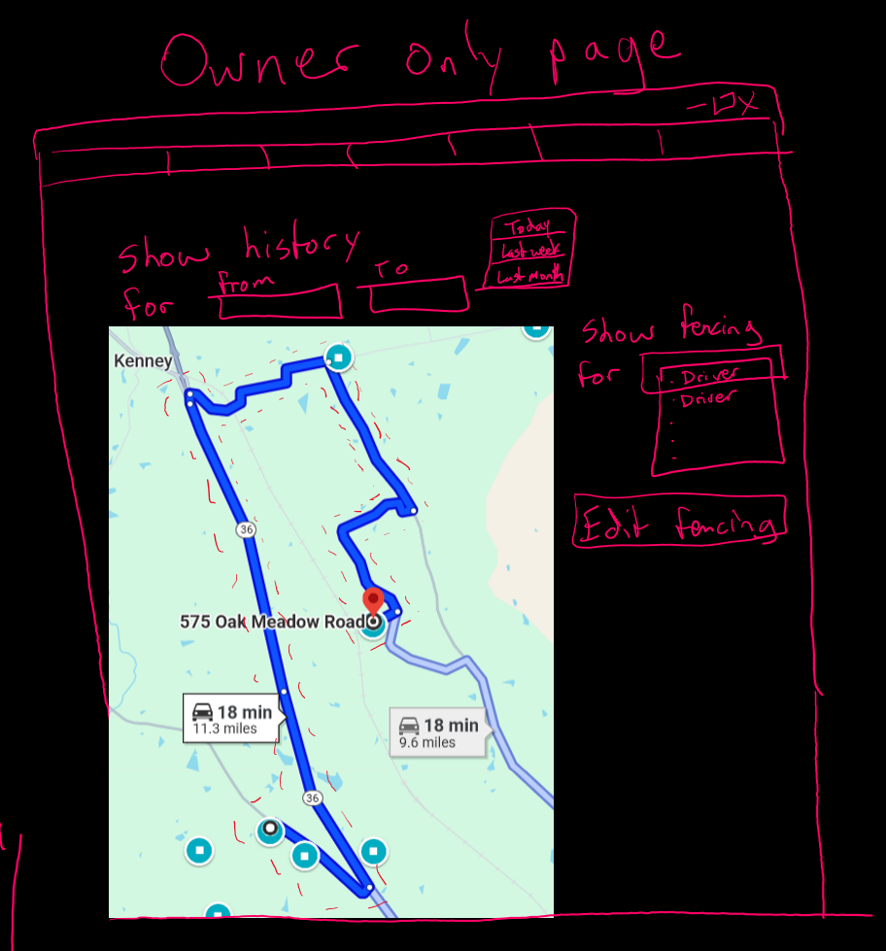
GPS Fencing and History Owner Only Screen
The current GPS location, GPS History, Geofencing for current vehicle, and ability to create a customized Geofence perimeter can all be accessed from this screen. This screen can only be seen and accessed by the owner.

Slide 18
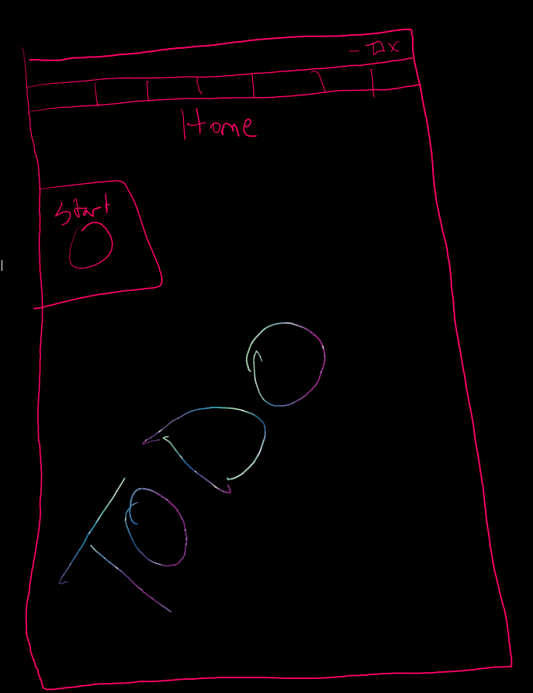
Home Screen
To be completed in next call

Slide 19
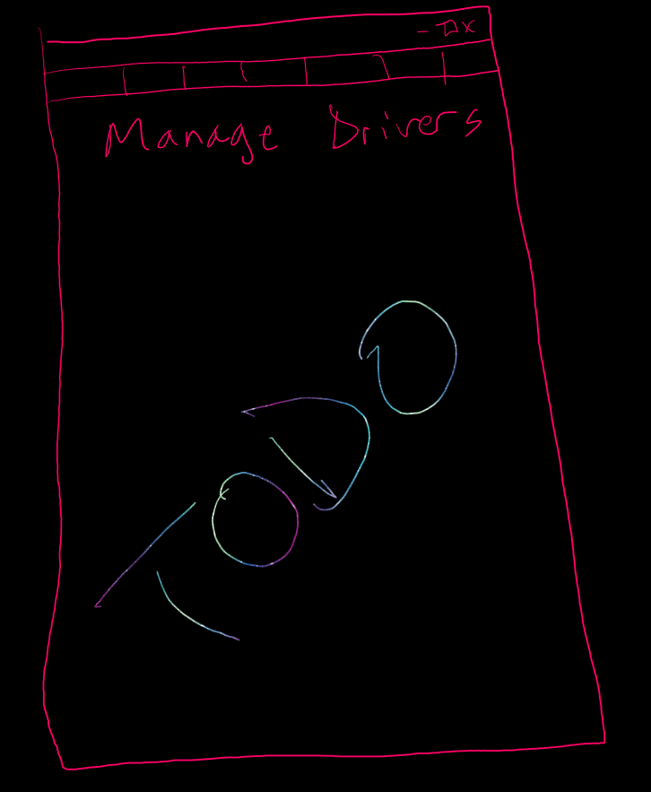
Manage Drivers Screen
To be completed in next call

Slide 20
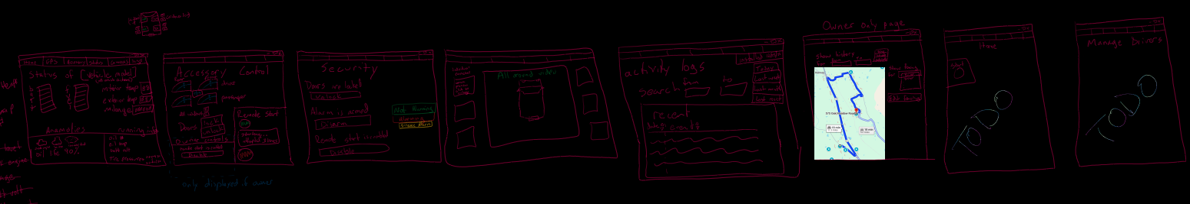
Group shot of all current mockup screens with notes - 3

Slide 21
Collaboration 10/21
It was decided to change to using Zoom for easier screen sharing with the drawing software being utilized. Following up from the 10/13 note, it was verified the interface drawing is to be wireframing without screen/button interactions being reflected.
After discussion, it was determined that the best way to improve modularity and separation of concerns was to start with creating the end pages and build backwards to the menu screen to drive modularity and separation of concerns. You can see from the chronologically ordered drawings above how it was ultimately approached.
Robert Colvin used a touchscreen with stylus for the mock-up drawings while we collaborated live over a Zoom call. This allowed for quick detailed feedback and rapid decision making.
As this is a computer based Windows application, it was decided to utilize a navigation bar/menu on the top. This will include the navigation tools at the top of the window which would be persistent across all pages for consistency of experience. Selections to go to the other screens, forward and back buttons, etc. will be located there.
After discussion, it was decided to list mileage twice, in the log and status screens, to prevent the user from needing to remember information and instead have it readily available for reference.
For status page, listing the running information and a section for warning indicators was used. The anomalies warning indicators will only appear when they are triggered by the vehicle.
Opted to list the battery charge and fuel here, if a hybrid it will list both bars. The screen readout overall will change based on the vehicle being reflected.
The team would like user feedback on if the app should track the anomalies in the log/journal?
There was discussion around whether to use the colors Green or red for showing a window up or down? Potentially also using the color in conjunction with percentage to reflect the information both ways. However, it was determined that the color and percentage could be interpreted as up or down depending on the user. Instead, it was changed to show an “outside the car” view with an actual representation of each window being up to down which appears to remove the potential for confusion and alleviates concern from with color blindness.
After discussion it was decided to hold off on adding a trunk lock/unlock feature as that is outside of the scope of the initial report.
We will evaluate potentially putting the video log in the log screen at a later date.
Using a red dotted line to show geofencing on the GPS screen makes it visually attention grabbing. The same screen can be quickly switched to different drivers and has the other related GPS functionality selectable from that screen. It was determined that for user privacy and security, only the Owner can see and modify this screen.
The video feeds are not fixed at this time as the number of cameras in the final application is unknown.

Slide 22
Collaboration 10/21
Scheduled next call for 10/23 to conclude Phase 1 report out
Home Screen
Manage Drivers
Technician Screen

Slide 23
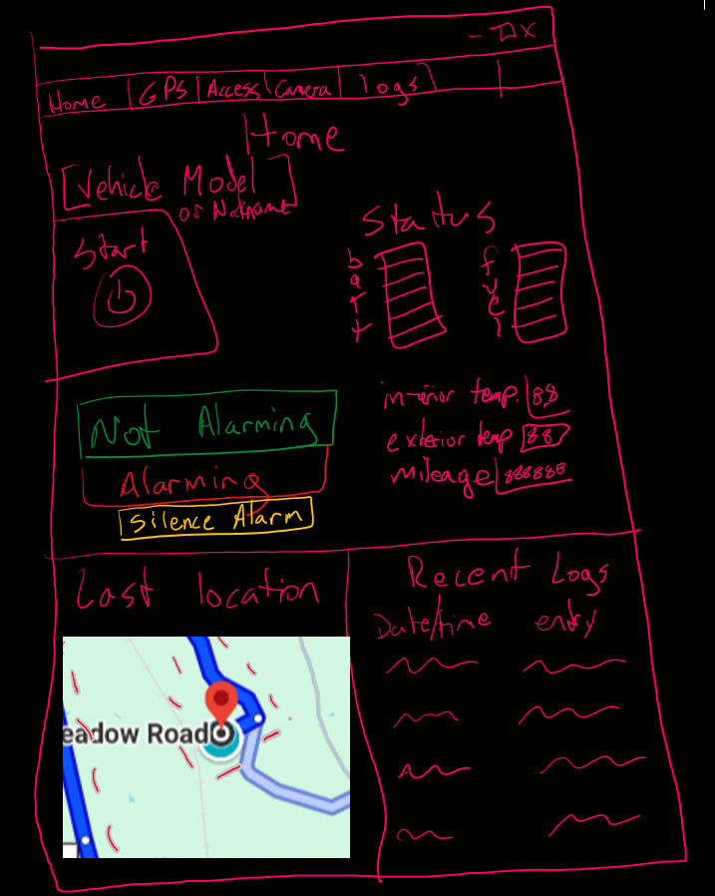
Home Screen
A screen to choose the vehicle to be selected and includes a snapshot of the vehicle information from several other screens to make it easy for the user to perform quick operations.

Slide 24
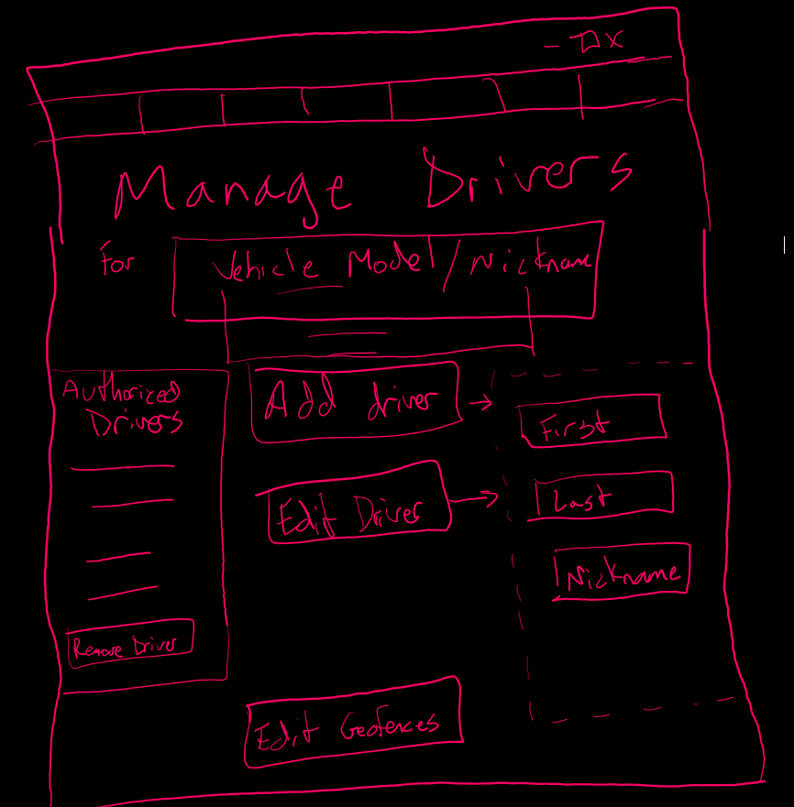
Manage Drivers Owner Only Screen
A screen to choose the vehicle, add, edit, or remove drivers and edit the geofences. This can only be accessed by the owner.
The specific details to be captured can be determined at a later date with user feedback.

Slide 25
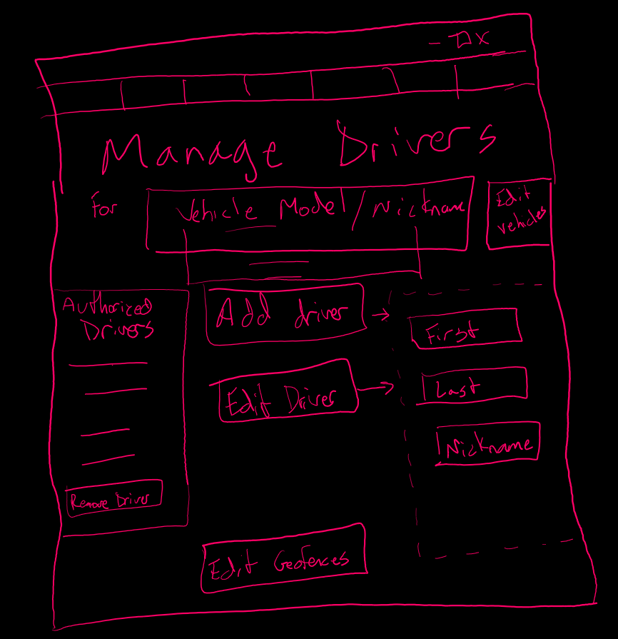
Manage Drivers Owner Only Screen – With Edit Vehicles Button
It was considered to potentially add the “Edit Vehicles” quick selection button here for easy access pending user feedback.

Slide 26
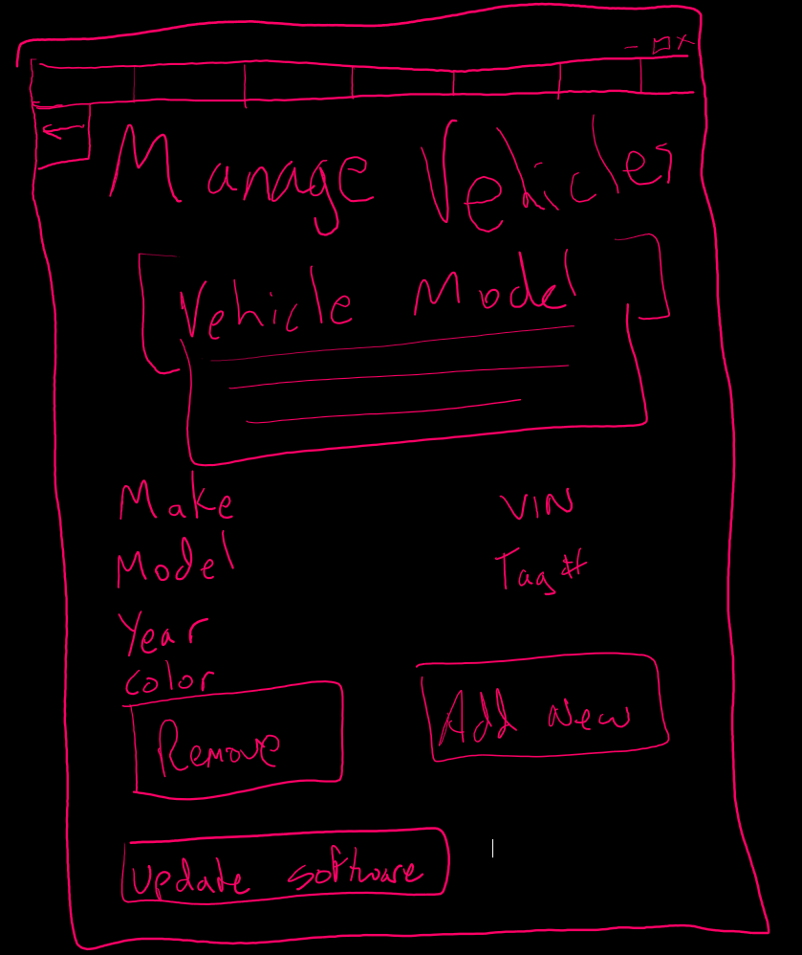
Manage Vehicles Owner Only Screen
A screen to choose the vehicle, add, edit, or remove vehicles. This can only be accessed by the owner.
General details are listed for example.
The specific details to be captured can be determined at a later date with user feedback.
The software can also be updated from this screen.

Slide 27
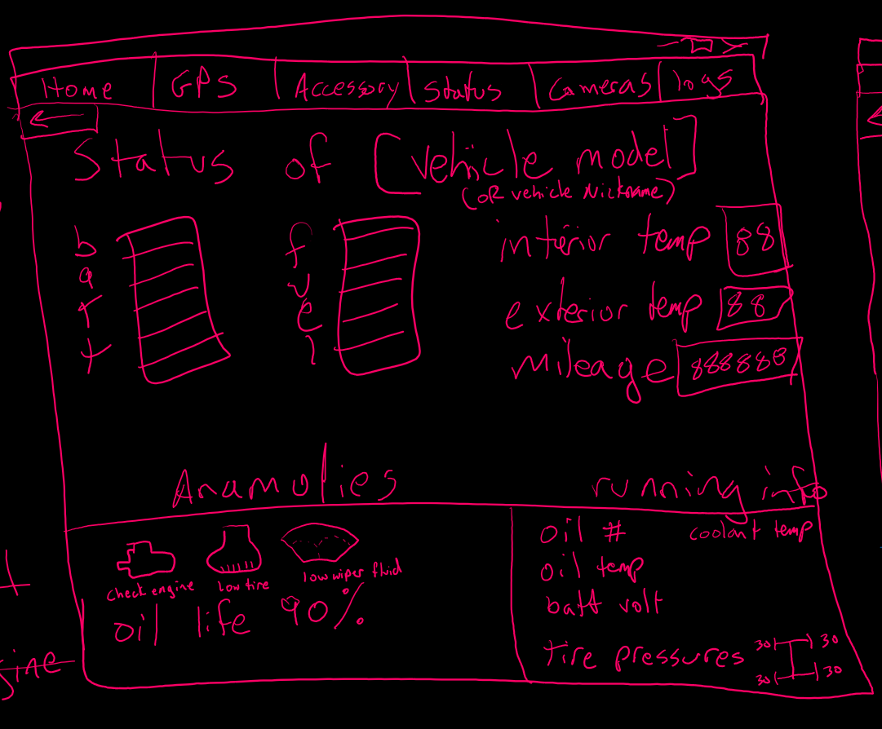
Vehicle Status Screen
The intention is to quickly show the current usability status of the vehicle. Are there any issues, fuel or battery charge status (if a hybrid, both bars will be reflected), etc.
UPDATE – Added engine temperature to screen as this was noted as a critical requirement.

Slide 28
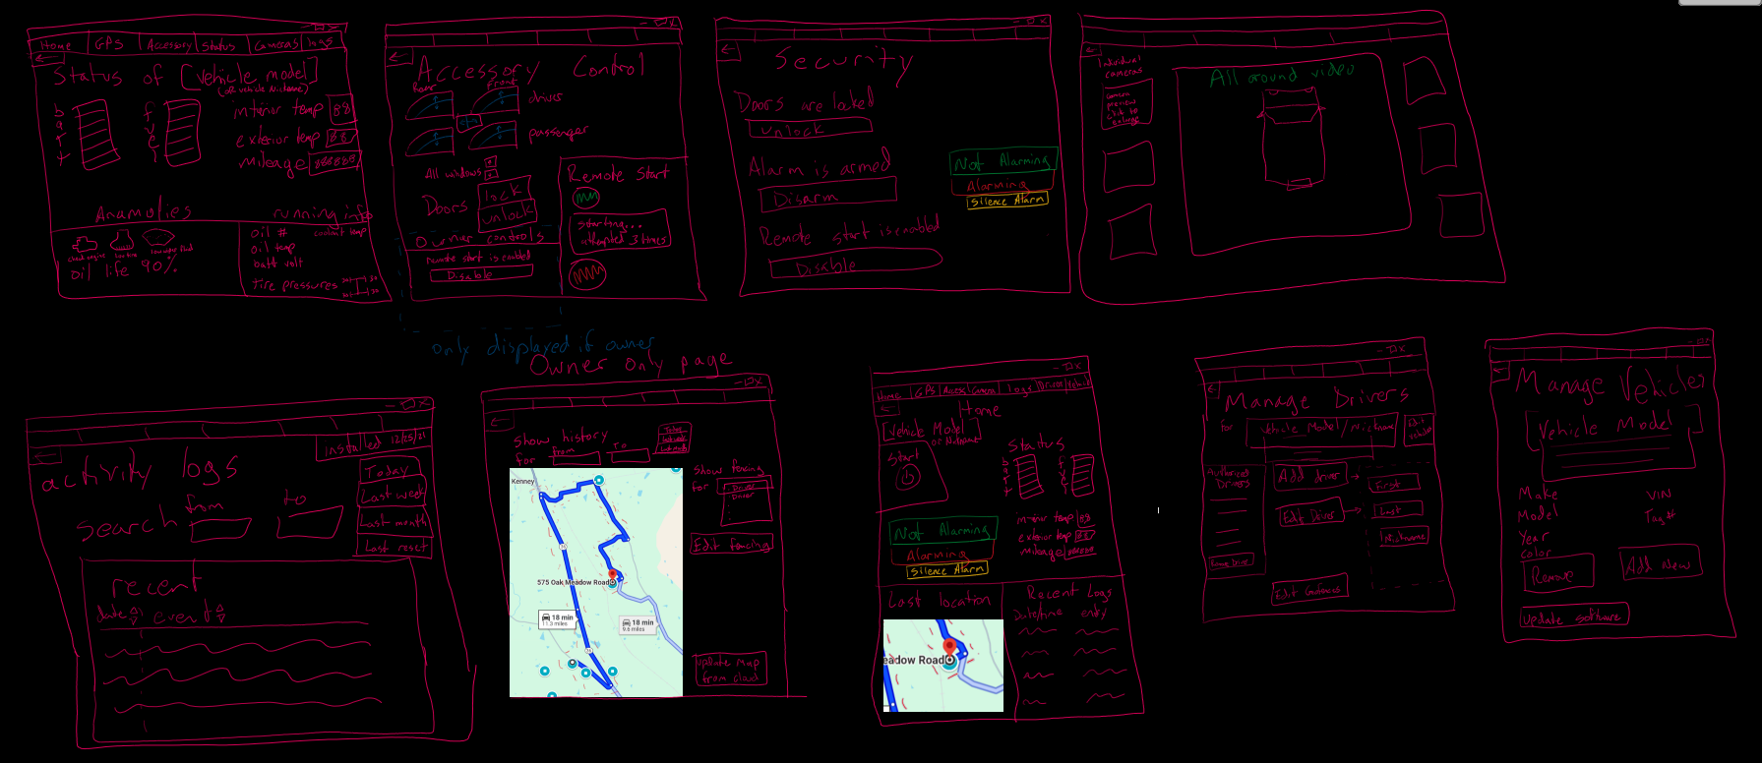
Group shot of all current mockup screens with notes - 4

Slide 29
Collaboration 10/23
After consideration, it was determined that placing the Remove Driver in the Driver Name List as an option that appears when a name is selected.
The screen menus will contain the standard home/back/forward navigation buttons to aid users who may not be comfortable with going through the screens. This allows another option to re-orient themselves as the application is being used.
Log formatting is kept general and will be updated later based on user feedback
It was opted to not include:
Technician specific screen is not reflected at this time as that will be not visible to the user
Initial syncing protocols and options as that will be handled by the installing technician
Full menu list in detail as that will change at a later date after user feedback

